Slide 1
Presentation | 2022-12-13
Accelerated Diffusion Models for
Protein Structure Generation
Haowei Lin, Shenshen Li, Yuzhe Wang
Peking University
{linhaowei, lssastar, wangyuzhe_ccme}@pku.edu.cn
Notes:
蛋白质生成扩散模型的加速算法

Slide 2
Outline
Motivation
De novo Protein Design
Diffusion-based Protein Structure Generation
Accelerated Sampling for Diffusion Models
Method
Evaluation Metric of Sample Quality
Representation of Protein Structures
Algorithm Sketch
Experiments and Conclusion
Results and Analysis
Comparison of Various Acceleration Methods
Conclusion

Slide 3
Outline
Motivation
De novo Protein Design
Diffusion-based Protein Structure Generation
Accelerated Sampling for Diffusion Models
Method
Evaluation Metric of Sample Quality
Representation of Protein Structures
Algorithm Sketch
Experiments and Conclusion
Results and Analysis
Comparison of Various Acceleration Methods
Conclusion

Slide 4
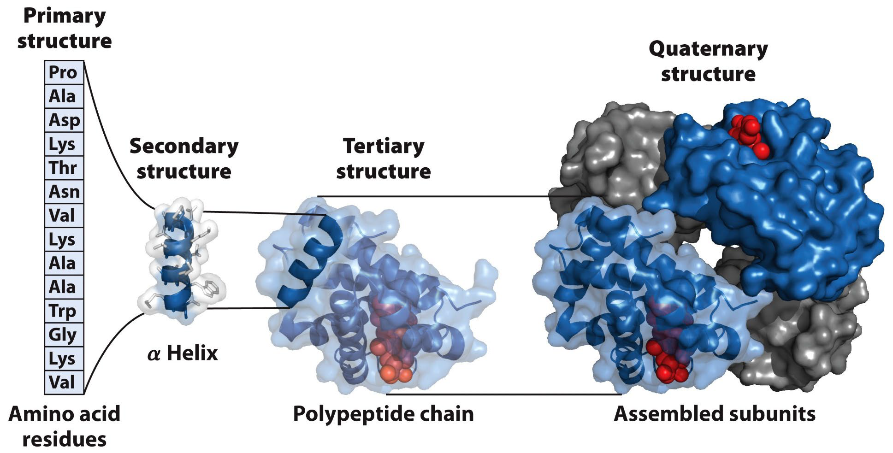
De novo Protein Design
Proteins: workhorse molecules of life
Protein functions: antibodies, enzymes, messengers…
4 levels of structure in proteins
Nelson, D. L., Lehninger, A. L., & Cox, M. M. (2008). Lehninger principles of biochemistry. Macmillan.
Notes:
蛋白质是生命活动的主要承担者：免疫过程（抗体），催化过程（酶），信号转导过程（激素）
蛋白质的四级结构

Slide 5
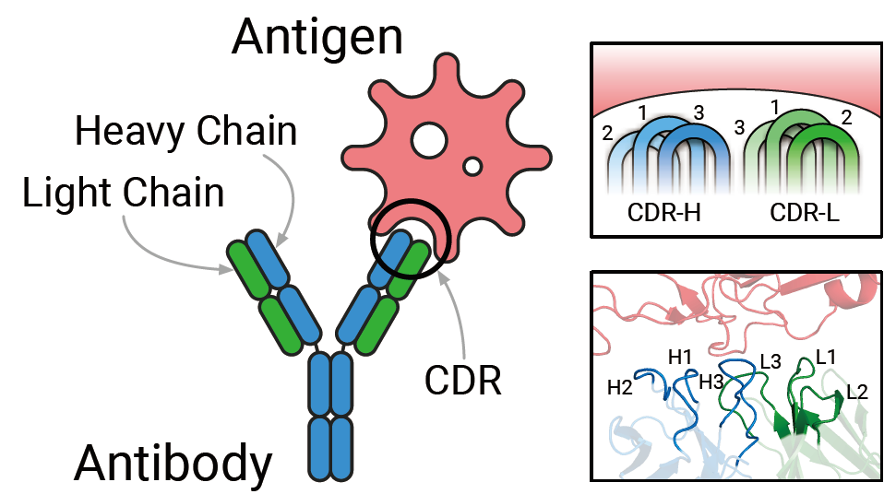
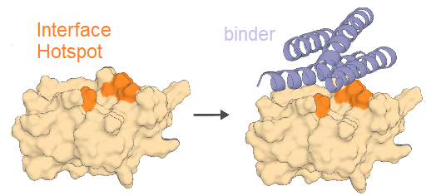
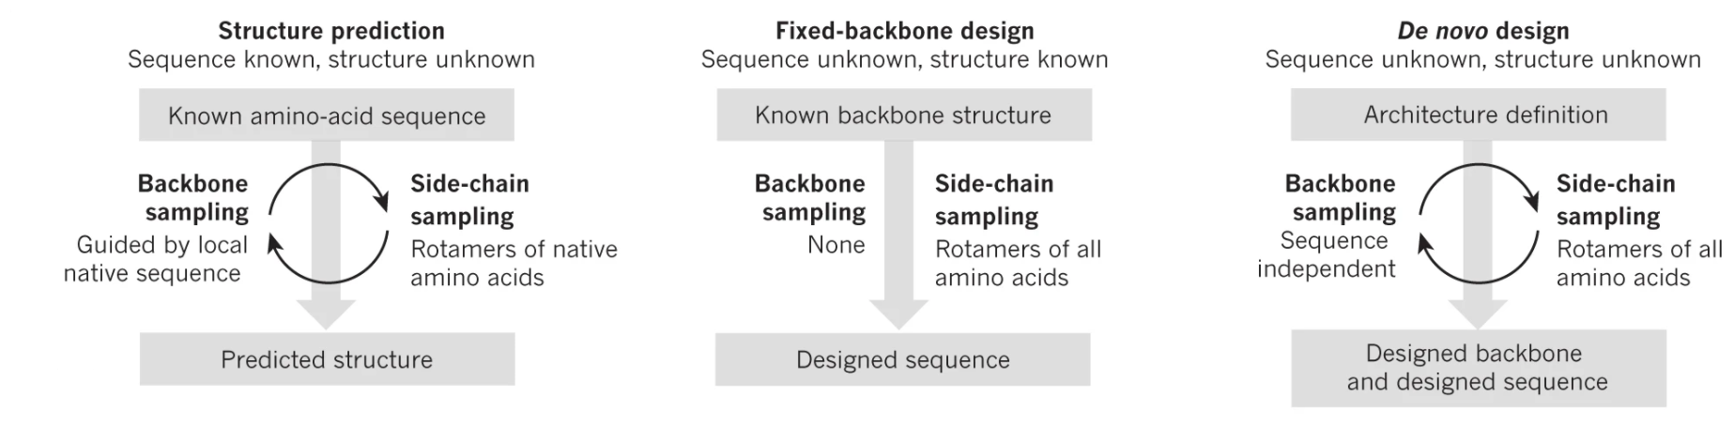
De novo Protein Design
Protein structure generation
Generating novel protein structures for antibody design and drug discovery
Challenge of computational de novo protein design
☑ AlphaFold2 ☑ Rosetta fixbb
Luo, S., Su, Y., Peng, X., Wang, S., Peng, J., & Ma, J. Antigen-Specific Antibody Design and Optimization with Diffusion-Based Generative Models for Protein Structures. In Advances in Neural Information Processing Systems.
Huang, P. S., Boyken, S. E., & Baker, D. (2016). The coming of age of de novo protein design. Nature, 537(7620), 320-327.
Notes:
抗体的设计：SARS-CoV-2 抗原抗体识别 轻链L和重链H CDR Loops 特定的构象
药物设计：新冠Mpro 短肽结合表面位点
过去近二十年时间 计算机辅助的蛋白质结构预测和设计取得了突破性进展 三个三个主要问题：结构预测 固定主链的侧链设计（已有骨架设计氨基酸序列） 从头设计，其中前两个问题被充分研究（AF2，传统的Rosetta fixbb模块和基于深度学习的rotamer packing），但de novo design一直以来依靠生物学家的经验进行，例如进行单个残基的突变+实验验证 或者使用经验势函数进行动力学模拟

Slide 6
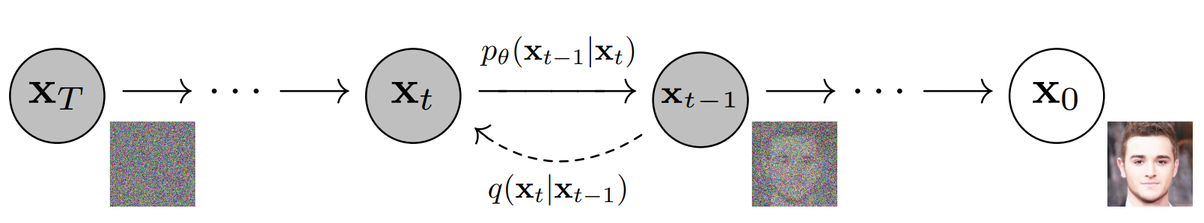
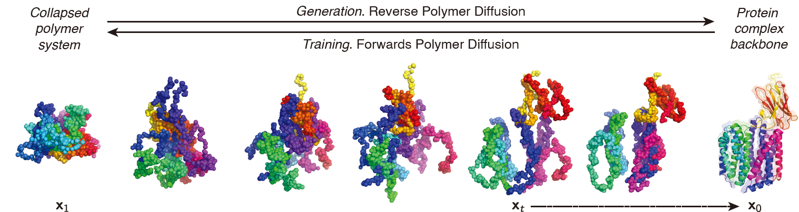
Diffusion-based Protein Structure Generation
Generative diffusion of protein structures
Ingraham, J., Baranov, M., Costello, Z., Frappier, V., Ismail, A., Tie, S., ... & Grigoryan, G. (2022). Illuminating protein space with a programmable generative model. bioRxiv.
Ho, J., Jain, A., & Abbeel, P. (2020). Denoising diffusion probabilistic models. Advances in Neural Information Processing Systems, 33, 6840-6851.
Notes:
Diffusion model SOTA 革新了蛋白质结构生成（de novo design）领域
类似于图像/文本生成 forward process/reverse process
Unconditional / guided diffusion

Slide 7
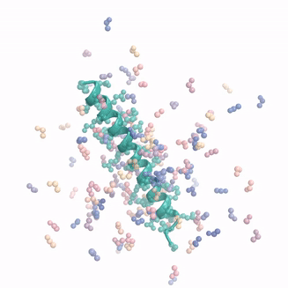
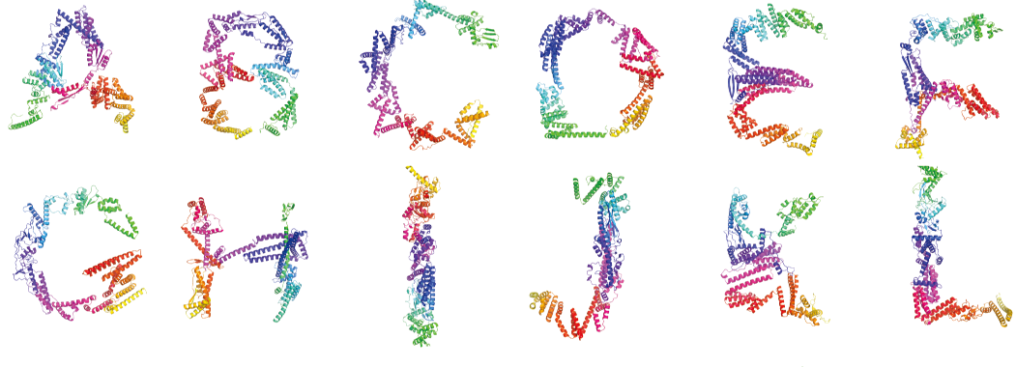
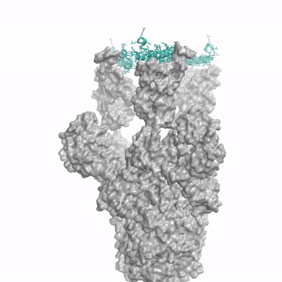
Diffusion-based Protein Structure Generation
Generative diffusion of protein structures
Existing problem: slow inference
Project aim: apply feasible accelerated sampling methods to protein structure generation
Improved efficiency of antibody design and drug discovery
Provide convenience for model refinement
Ingraham, J., Baranov, M., Costello, Z., Frappier, V., Ismail, A., Tie, S., ... & Grigoryan, G. (2022). Illuminating protein space with a programmable generative model. bioRxiv.
https://www.bakerlab.org/2022/11/30/diffusion-model-for-protein-design/
Notes:
Chroma（12.1）；RFDiffusion（David Baker, 12.2）
Chroma：几何形状，对称性，甚至自然语言prompt
RFDiffusion：PTH binder，靶向SARS-Cov-2-Spike蛋白的药物设计
但目前diffusion-based protein generation存在问题 inference阶段较慢（后面结果部分展示），既是diffusion model自身的问题，同时由于蛋白质结构复杂，模型通常比较庞大
为什么提升蛋白质结构生成的速度？→提升药物/抗体设计的效率（生成模型sampling大量可能的结构 再做virtual screening或实验验证）；同时也便于根据模型表现对模型进行微调

Slide 8
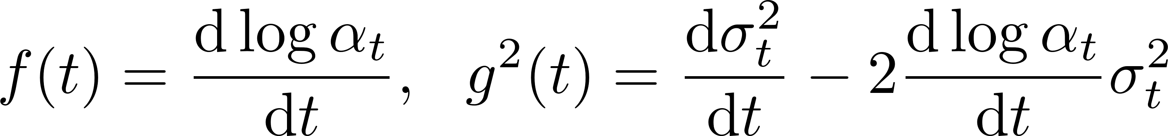
Accelerated Sampling for Diffusion Models
Accelerated sampling methods
Training-based: knowledge distillation, self-adaptive noise scheduling, Sample trajectory learning
Training-free: DDIM, Dynamic stepsize SDE solver, Analytic-DPM, DPM-Solver, DPM-Solver++ (both used in Stable-Diffusion)
Algorithm sketch of DPM-Solver/DPM-Solver++
Essence: fast ODE solver for the probability flow ODE
or equivalent the diffusion ODE
in which
Song, Y., Sohl-Dickstein, J., Kingma, D. P., Kumar, A., Ermon, S., & Poole, B. (2020). Score-based generative modeling through stochastic differential equations. arXiv preprint arXiv:2011.13456.
Lu, C., Zhou, Y., Bao, F., Chen, J., Li, C., & Zhu, J. (2022). DPM-Solver: A Fast ODE Solver for Diffusion Probabilistic Model Sampling in Around 10 Steps.
arXiv preprint arXiv:2206.00927.
Notes:
To our best knowledge 目前尚未运用在蛋白质生成领域
两类：training-based，training-free
Probability flow ODEs: see [Song et al., 2020] ICLR
α_t和σ_t都是diffusion model的noise schedule
Diffusion ODE相比于SDE（stochastic differential equation）求解更加robust（没有随机项），一般而言可以在数值求解时取更大的步长，而数值求解ODE在数值计算领域已经发展了一系列成熟的方法
Song等发展的DDIM RK45 ODE solver求解Diffusion ODEs
Semi-linear structure

Slide 9
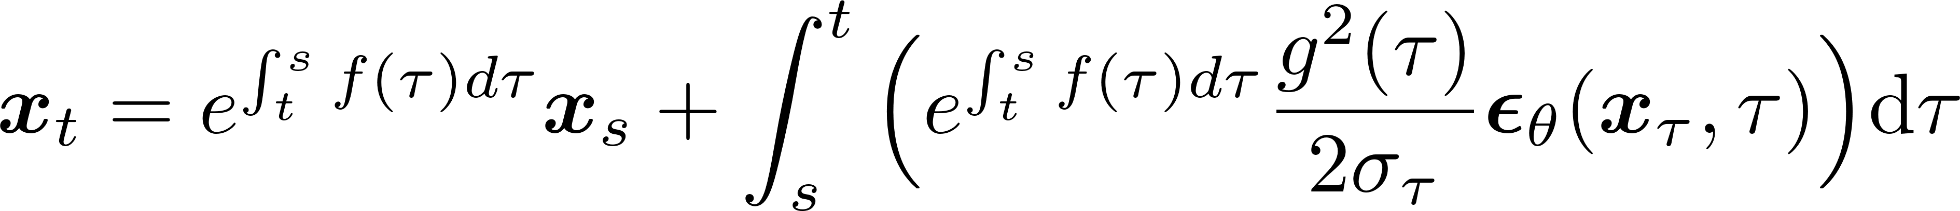
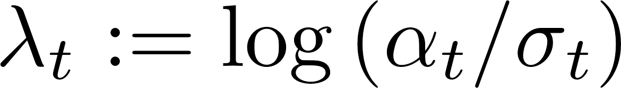
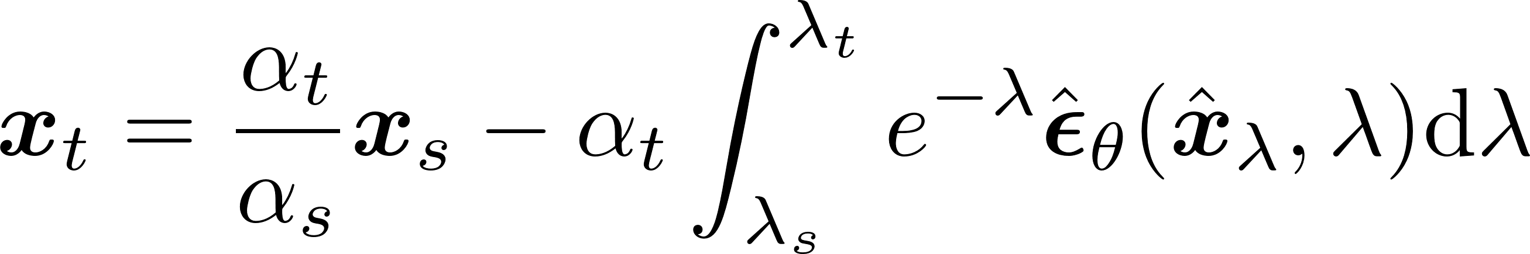
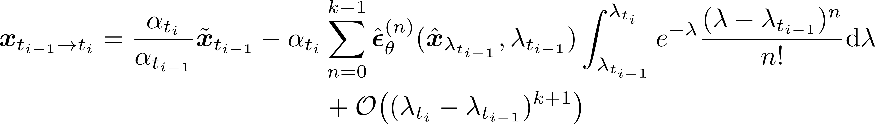
Accelerated Sampling for Diffusion Models
Accelerated sampling methods
Algorithm sketch of DPM-Solver/DPM-Solver++
Decouple linear parts and nonlinear parts of the diffusion ODE by variation of constants formula to formulate the exact solution
Rewrite the solution by change-of-variable for
Apply (k-1)-th order Taylor expansion to the NN term and compute the integral analytically using integration-by-parts to obtain DPM-Solver-k
Song, Y., Sohl-Dickstein, J., Kingma, D. P., Kumar, A., Ermon, S., & Poole, B. (2020). Score-based generative modeling through stochastic differential equations. arXiv preprint arXiv:2011.13456.
Lu, C., Zhou, Y., Bao, F., Chen, J., Li, C., & Zhu, J. (2022). DPM-Solver: A Fast ODE Solver for Diffusion Probabilistic Model Sampling in Around 10 Steps.
arXiv preprint arXiv:2206.00927.
Notes:
Diffusion ODE: semi-linear ODE structure
解ODE的variation of constants trick
变量代换 引入λ（log-signal-to-noise ratio信噪比的1/2）
泰勒展开 分部积分 解析地计算
以DPM-Solver为例，DPM-Solver++的算法是完全类似的，只是solve diffusion ODEs of x_\theta rather than \epsilon_\theta in DPM-Solver

Slide 10
Outline
Motivation
De novo Protein Design
Diffusion-based Protein Structure Generation
Accelerated Sampling for Diffusion Models
Method
Evaluation Metric of Sample Quality
Representation of Protein Structures
Algorithm Sketch
Experiments and Conclusion
Results and Analysis
Comparison of Various Acceleration Methods
Conclusion

Slide 11
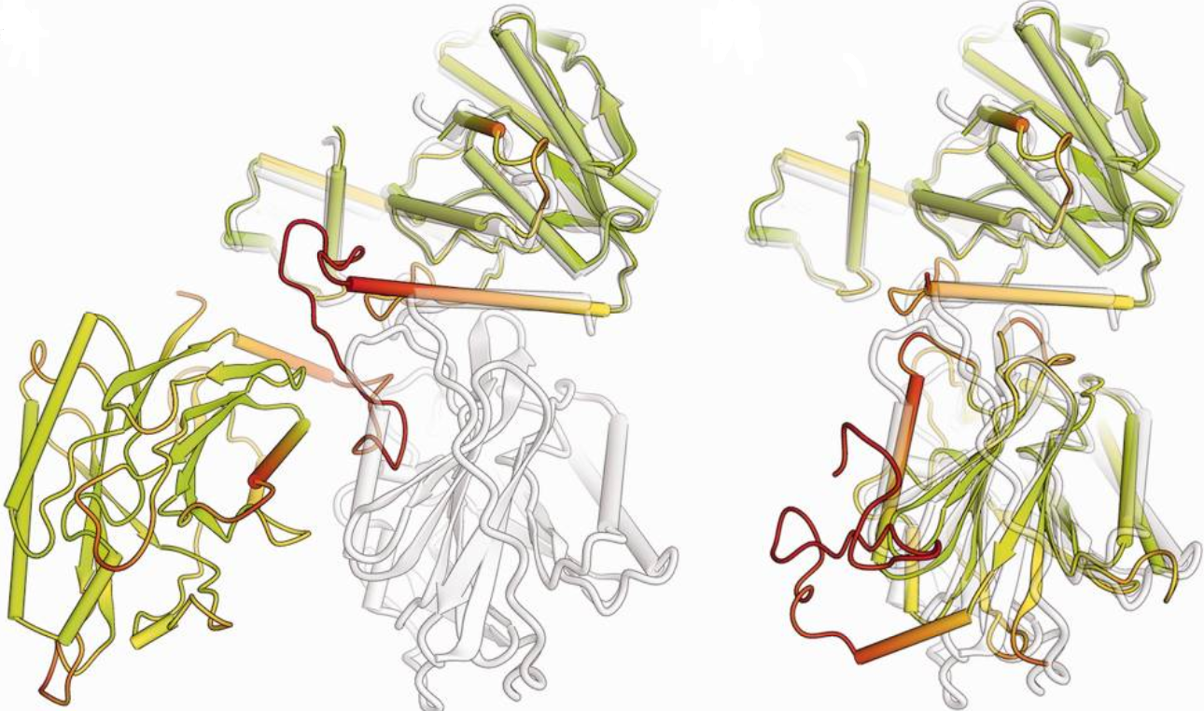
Evaluation Metric of Sample Quality
Sample quality assessment
Image/text generation: perplexity, FID, inception score etc.
Quality assessment of generated protein structures? → structure generation of given amino acid sequence (whose ground-truth structure is known)
Evaluation metrics: lDDT (local Distance Difference Test)
lDDT measures how well the environment in a reference structure is reproduced in a protein model (fraction of reproduced atom pairs, ↑)
Superposition-free
Mariani, V., Biasini, M., Barbato, A., & Schwede, T. (2013). lDDT: a local superposition-free score for comparing protein structures and models using distance difference tests. Bioinformatics, 29(21), 2722-2728.
Notes:
Left: global superposition; right: superposition-free (lDDT)

Slide 12
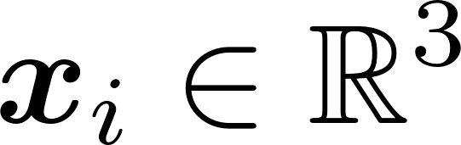
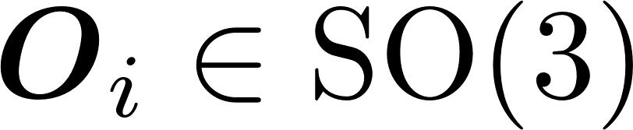
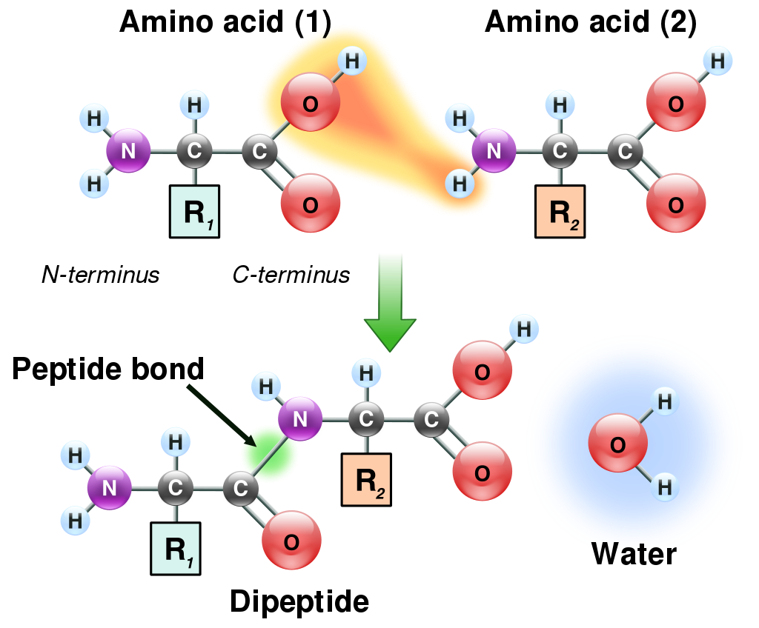
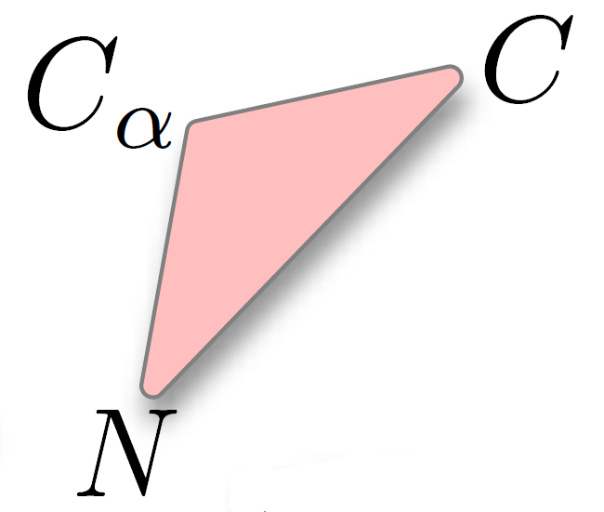
Representation of Protein Structures
Representation of an amino acid in a protein complex
Amino acid type:
Cα atom coordinate:
Orientation:
Orientation
Luo, S., Su, Y., Peng, X., Wang, S., Peng, J., & Ma, J. Antigen-Specific Antibody Design and Optimization with Diffusion-Based Generative Models for Protein Structures. In Advances in Neural Information Processing Systems.
https://en.wikipedia.org/wiki/Amino_acid

Slide 13
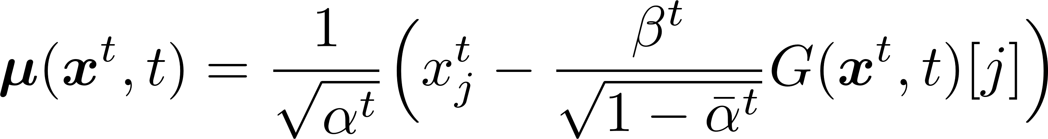
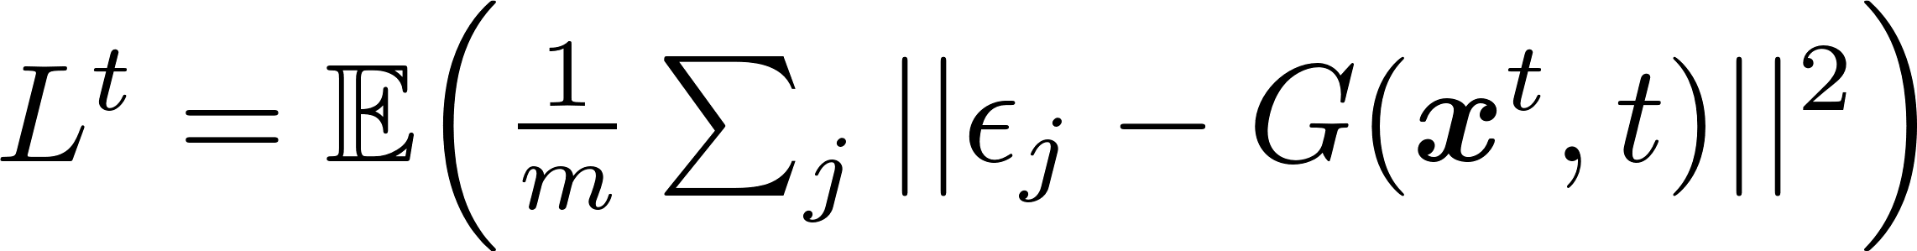
Algorithm Sketch
Diffusion for Cα coordinates
Forward diffusion
Generative process
Objective function
Luo, S., Su, Y., Peng, X., Wang, S., Peng, J., & Ma, J. Antigen-Specific Antibody Design and Optimization with Diffusion-Based Generative Models for Protein Structures. In Advances in Neural Information Processing Systems

Slide 14
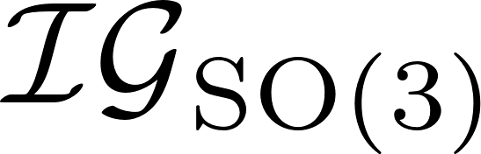
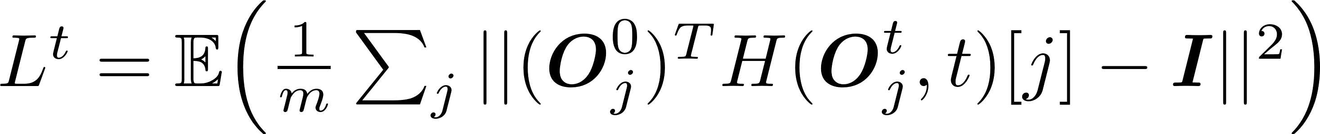
Algorithm Sketch
Diffusion for amino acid orientations
Forward diffusion
denotes the isotropic Gaussian distribution on SO(3)
Generative process
Objective function
Luo, S., Su, Y., Peng, X., Wang, S., Peng, J., & Ma, J. Antigen-Specific Antibody Design and Optimization with Diffusion-Based Generative Models for Protein Structures. In Advances in Neural Information Processing Systems

Slide 15
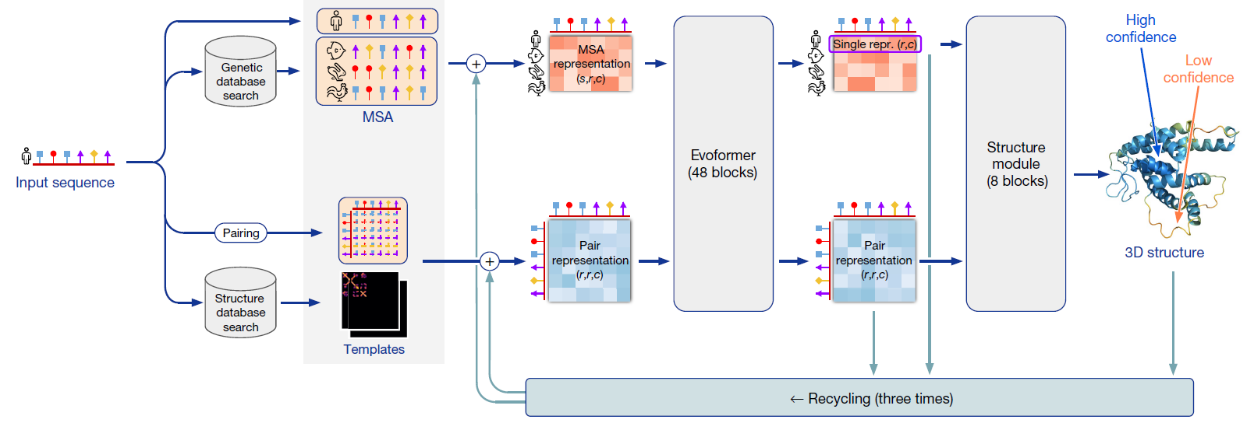
Algorithm Sketch
Sequence condition
Latent feature of protein sequences: pretrained AlphaFold2 Evoformer
Model architecture backbone: pretrained AlphaFold2 structure module
Jumper, J., Evans, R., Pritzel, A., Green, T., Figurnov, M., Ronneberger, O., ... & Hassabis, D. (2021). Highly accurate protein structure prediction with AlphaFold. Nature, 596(7873), 583-589.

Slide 16
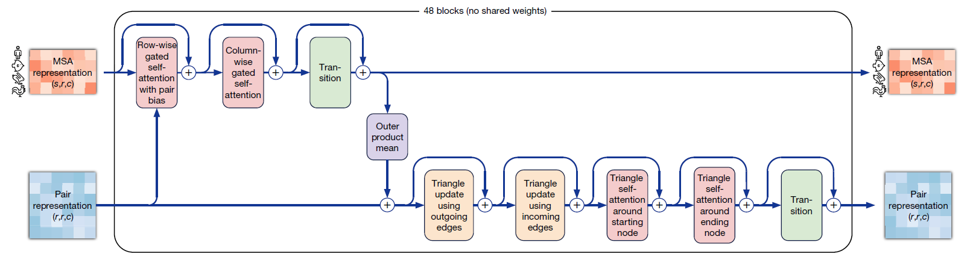
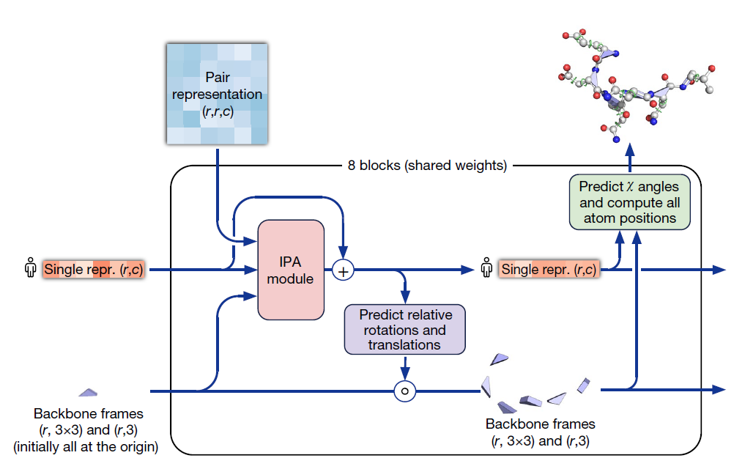
Algorithm Sketch
Sequence condition
Latent feature of protein sequences: pretrained AlphaFold2 Evoformer
Model architecture backbone: pretrained AlphaFold2 structure module
Jumper, J., Evans, R., Pritzel, A., Green, T., Figurnov, M., Ronneberger, O., ... & Hassabis, D. (2021). Highly accurate protein structure prediction with AlphaFold. Nature, 596(7873), 583-589.
Notes:
Evoformer; structure module

Slide 17
Outline
Motivation
De novo Protein Design
Diffusion-based Protein Structure Generation
Accelerated Sampling for Diffusion Models
Method
Evaluation Metric of Sample Quality
Representation of Protein Structures
Algorithm Sketch
Experiments and Conclusion
Results and Analysis
Comparison of Various Acceleration Methods
Conclusion

Slide 18
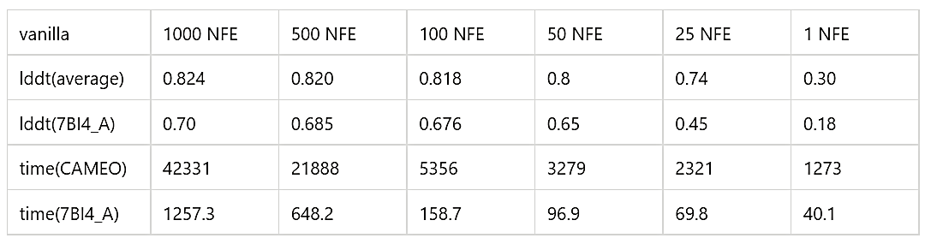
Results and Analysis
Baseline performances of the vanilla diffusion model
Test set: CAMEO dataset which consists 146 of the most recent single-chain proteins
Case study: protein PDB_ID = 7BI4_A (on which all accelerated sampling algorithms are tested)
The test results for the vanilla diffusion model

Slide 19
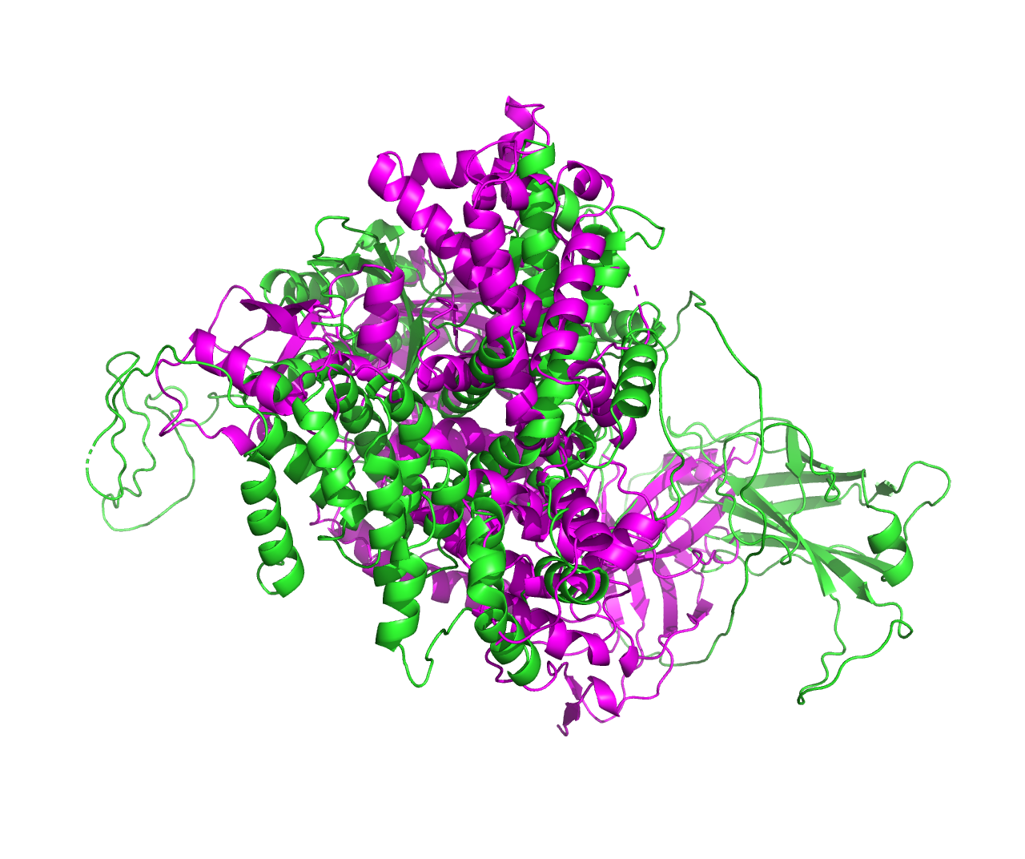
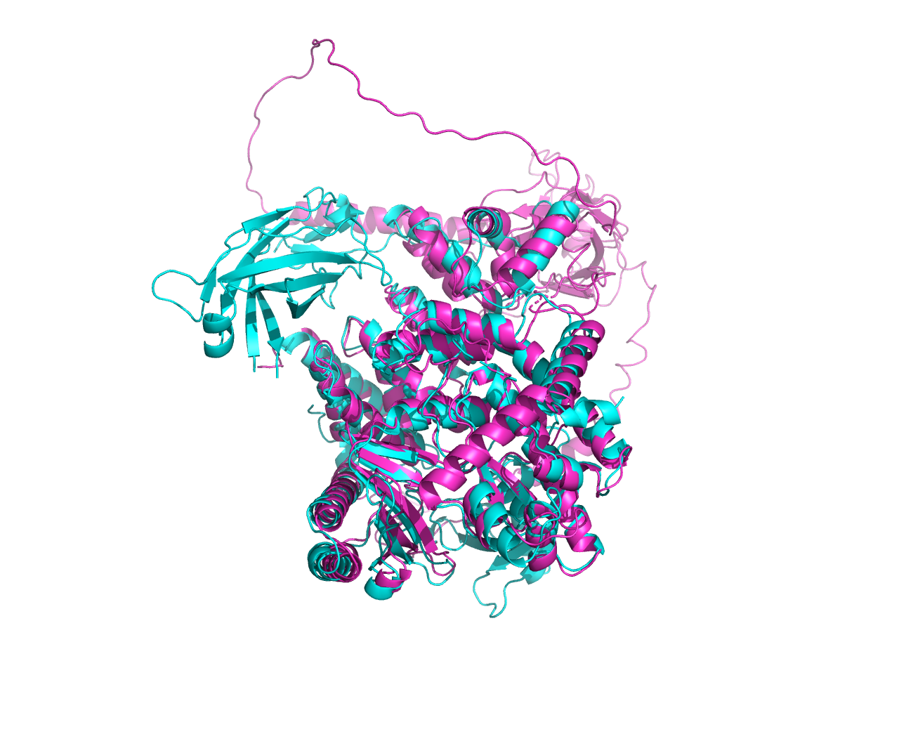
Results and Analysis
The 3D structure of Real and predicted (50 NFE / 1000 NFE) 7Bl4_A
50 NFE, lddt=0.65, time=96.9 s
1000 NFE, lddt=0.70, time=1257.3 s

Slide 20
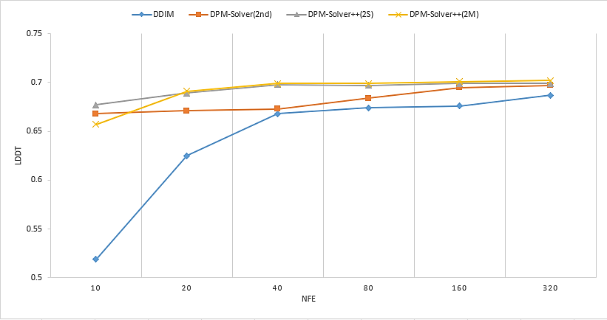
Comparison of Various Acceleration Methods
The results of 7Bl4_A
DPM-Solver++ converges at about 40 NFE and outperforms all other algorithms
DPM-Solver performs slightly worse than DPM-Solver++ but beats DDIM

Slide 21
Conclusion
For 7Bl4_A:
The acceleration methods significantly improve the convergence speed of the model by a large margin (1000 NFE → 40 NFE, 1200 s → 60 s)
DPM-Solver++ performs best when applied to diffusion-based protein structure generation
DDIM performs the worst (no convergence at 320 NFE)

Slide 22
Thank you
Haowei Lin, Shenshen Li, Yuzhe Wang
Peking University
{linhaowei, lssastar, wangyuzhe_ccme}@pku.edu.cn

